Slide 1
Data Analytics (CS3203N)
Lecture #8
Classification: Naïve Bayes’ Classifier

Slide 2

An interesting fact..
No number before 1,000 contains the letter A.
But there are plenty of E’s, I’s, O’s, U’s, and Y’s.

Slide 3
Today’s discussion…
Introduction to Classification
Classification Techniques
Supervised and unsupervised classification
Formal statement of supervised classification technique
Bayesian Classifier
Principle of Bayesian classifier
Bayes’ theorem of probability
Naïve Bayesian Classifier

Slide 4
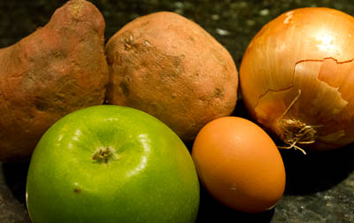
A Simple Quiz: Identify the objects

Slide 5
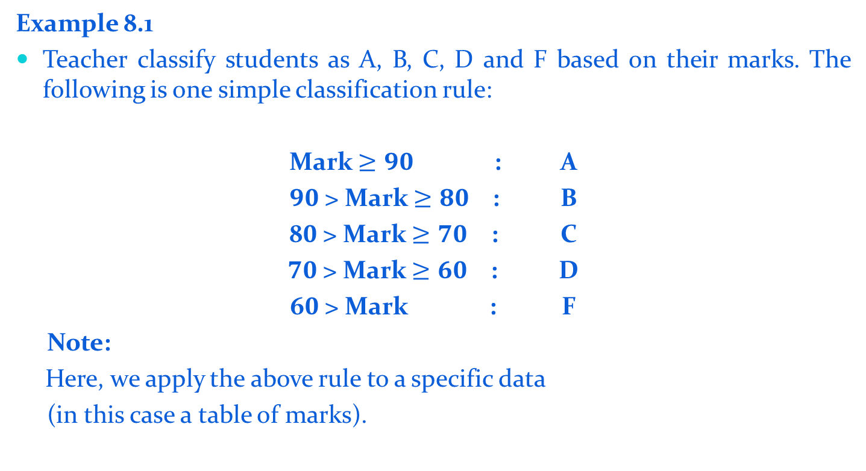
Introduction to Classification
Example 8.1
Teacher classify students as A, B, C, D and F based on their marks. The following is one simple classification rule:
Mark $≥90$ : A
$90$> Mark $≥80$ : B
8$0$> Mark $≥70$ : C
$70$> Mark $≥60$ : D
6$0$> Mark : F
Note:
Here, we apply the above rule to a specific data
(in this case a table of marks).

Slide 6
Examples of Classification in Data Analytics
Life Science: Predicting tumor cells as benign or malignant
Security: Classifying credit card transactions as legitimate or fraudulent
Prediction: Weather, voting, political dynamics, etc.
Entertainment: Categorizing news stories as finance, weather, entertainment, sports, etc.
Social media: Identifying the current trend and future growth

Slide 7
Classification : Definition
Classification is a form of data analysis to extract models describing important data classes.
Essentially, it involves dividing up objects so that each is assigned to one of a number of mutually exhaustive and exclusive categories known as classes.
The term “mutually exhaustive and exclusive” simply means that each object must be assigned to precisely one class
That is, never to more than one and never to no class at all.

Slide 8
Classification Techniques
Classification consists of assigning a class label to a set of unclassified cases.
Supervised Classification
The set of possible classes is known in advance.
Unsupervised Classification
Set of possible classes is not known. After classification we can try to assign a name to that class.
Unsupervised classification is called clustering.

Slide 9

Supervised Classification

Slide 10

Unsupervised Classification

Slide 11
Supervised Classification Technique
Given a collection of records (training set )
Each record contains a set of attributes, one of the attributes is the class.
Find a model for class attribute as a function of the values of other attributes.
Goal: Previously unseen records should be assigned a class as accurately as possible.
Satisfy the property of “mutually exclusive and exhaustive”

Slide 12
Illustrating Classification Tasks

Slide 13
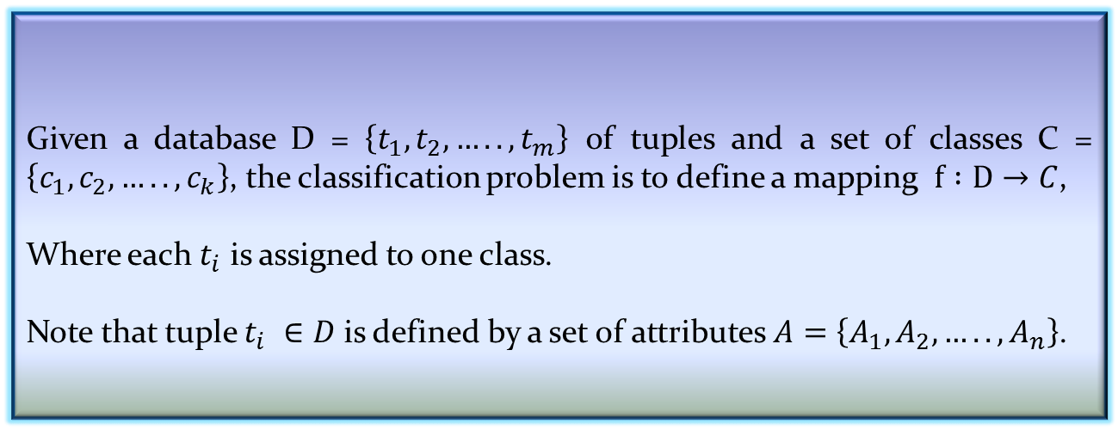
Classification Problem
More precisely, a classification problem can be stated as below:
Given a database D = $\left\{t_{1},t_{2},…..,t_{m}\right\}$ of tuples and a set of classes C = $\left\{c_{1},c_{2},…..,c_{k}\right\}$, the classification problem is to define a mapping $f :D→C$,
Where each $t_{i}$ is assigned to one class.
Note that tuple $t_{i} ∈D$ is defined by a set of attributes $A=\left\{A_{1},A_{2},…..,A_{n}\right\}$.
Definition 8.1: Classification Problem

Slide 14
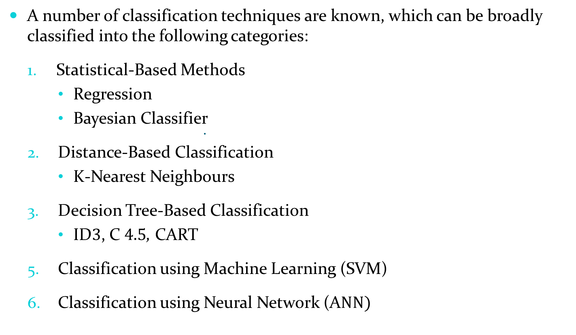
Classification Techniques
A number of classification techniques are known, which can be broadly classified into the following categories:
Statistical-Based Methods
Regression
Bayesian Classifier
Distance-Based Classification
K-Nearest Neighbours
Decision Tree-Based Classification
ID$3$, C $4.5$, CART
Classification using Machine Learning (SVM)
Classification using Neural Network (A$NN)$

Slide 15
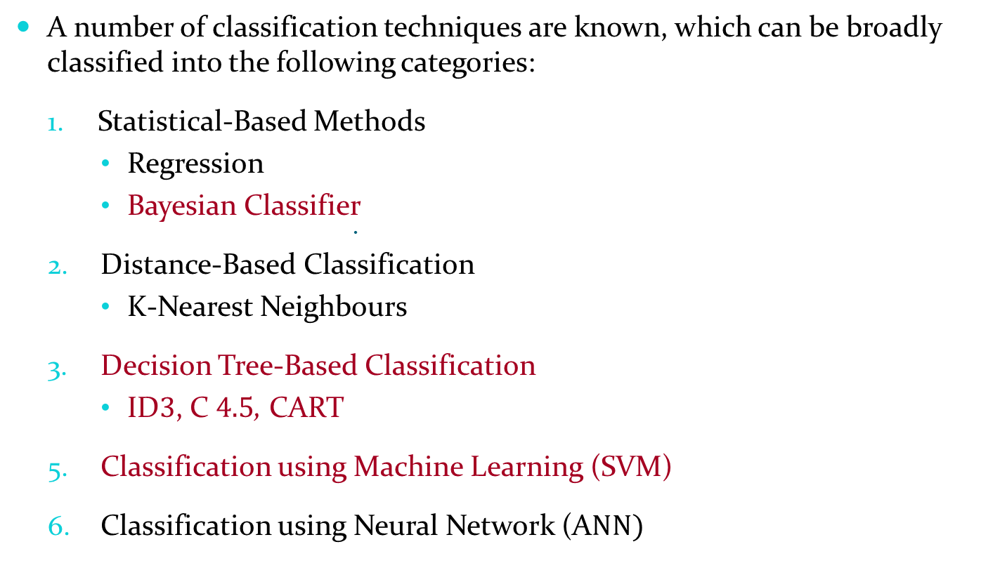
Classification Techniques
A number of classification techniques are known, which can be broadly classified into the following categories:
Statistical-Based Methods
Regression
Bayesian Classifier
Distance-Based Classification
K-Nearest Neighbours
Decision Tree-Based Classification
ID$3$, C $4.5$, CART
Classification using Machine Learning (SVM)
Classification using Neural Network (A$NN)$

Slide 16
Bayesian Classifier

Slide 17
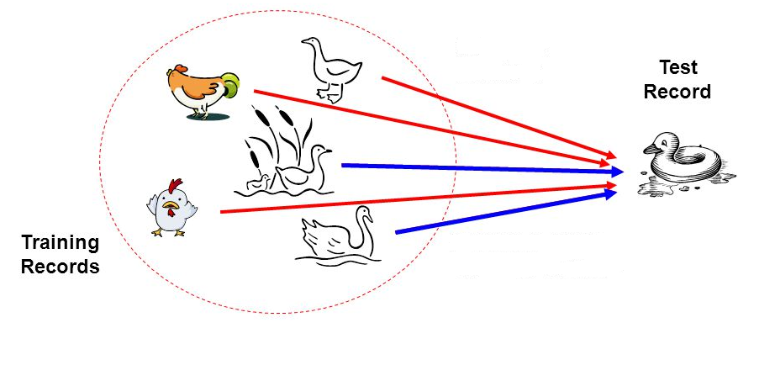
Bayesian Classifier
Principle
If it walks like a duck, quacks like a duck, then it is probably a duck

Slide 18
Bayesian Classifier
A statistical classifier
Performs probabilistic prediction, i.e., predicts class membership probabilities
Foundation
Based on Bayes’ Theorem.
Assumptions
The classes are mutually exclusive and exhaustive.
The attributes are independent given the class.
Called “Naïve” classifier because of these assumptions.
Empirically proven to be useful.
Scales very well.

Slide 19

Example: Bayesian Classification
Example 8.2: Air Traffic Data
Let us consider a set observation recorded in a database
Regarding the arrival of airplanes in the routes from any airport to New Delhi under certain conditions.

Slide 20
Air-Traffic Data
Days | Season | Fog | Rain | Class
Weekday | Spring | None | None | On Time
Weekday | Winter | None | Slight | On Time
Weekday | Winter | None | None | On Time
Holiday | Winter | High | Slight | Late
Saturday | Summer | Normal | None | On Time
Weekday | Autumn | Normal | None | Very Late
Holiday | Summer | High | Slight | On Time
Sunday | Summer | Normal | None | On Time
Weekday | Winter | High | Heavy | Very Late
Weekday | Summer | None | Slight | On Time
Cond. to next slide…

Slide 21
Air-Traffic Data
Cond. from previous slide…
Days | Season | Fog | Rain | Class
Saturday | Spring | High | Heavy | Cancelled
Weekday | Summer | High | Slight | On Time
Weekday | Winter | Normal | None | Late
Weekday | Summer | High | None | On Time
Weekday | Winter | Normal | Heavy | Very Late
Saturday | Autumn | High | Slight | On Time
Weekday | Autumn | None | Heavy | On Time
Holiday | Spring | Normal | Slight | On Time
Weekday | Spring | Normal | None | On Time
Weekday | Spring | Normal | Heavy | On Time

Slide 22
Air-Traffic Data
In this database, there are four attributes
A = [ Day, Season, Fog, Rain]
with 20 tuples.
The categories of classes are:
C= [On Time, Late, Very Late, Cancelled]
Given this is the knowledge of data and classes, we are to find most likely classification for any other unseen instance, for example:
Classification technique eventually to map this tuple into an accurate class.
Week Day | Winter | High | None | ???

Slide 23
Bayesian Classifier
In many applications, the relationship between the attributes set and the class variable is non-deterministic.
In other words, a test cannot be classified to a class label with certainty.
In such a situation, the classification can be achieved probabilistically.
The Bayesian classifier is an approach for modelling probabilistic relationships between the attribute set and the class variable.
More precisely, Bayesian classifier use Bayes’ Theorem of Probability for classification.
Before going to discuss the Bayesian classifier, we should have a quick look at the Theory of Probability and then Bayes’ Theorem.

Slide 24
Bayes’ Theorem of Probability

Slide 25
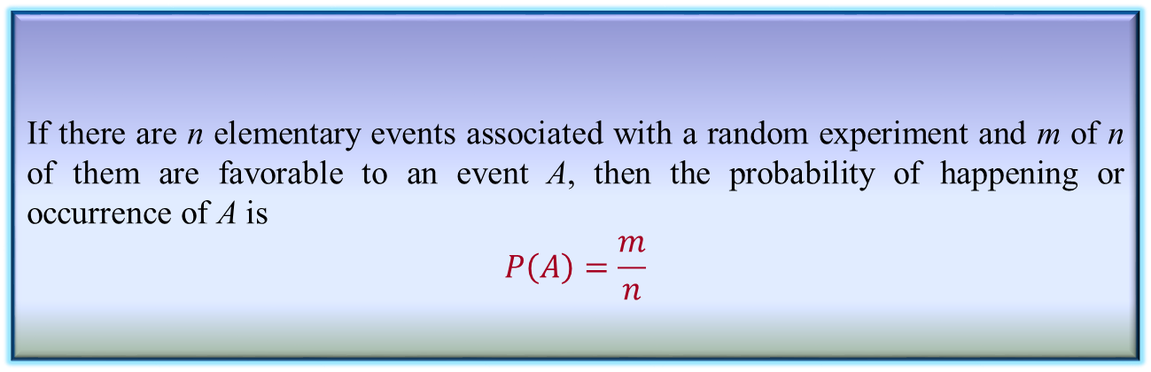
Simple Probability
Definition 8.2: Simple Probability
If there are n elementary events associated with a random experiment and m of n of them are favorable to an event A, then the probability of happening or occurrence of A is
$$P\left(A\right)=\frac{m}{n}$$

Slide 26

Simple Probability
Suppose, A and B are any two events and P(A), P(B) denote the probabilities that the events A and B will occur, respectively.
Mutually Exclusive Events:
Two events are mutually exclusive, if the occurrence of one precludes the occurrence of the other.
Example: Tossing a coin (two events)
Tossing a ludo cube (Six events)
Can you give an example, so that two events are not mutually exclusive?
Hint: Tossing two identical coins, Weather (sunny, foggy, warm)

Slide 27
Simple Probability
Independent events: Two events are independent if occurrences of one does not alter the occurrence of other.
Example: Tossing both coin and ludo cube together.
(How many events are here?)
Can you give an example, where an event is dependent on one or more other events(s)?
Hint: Receiving a message (A) through a communication channel (B)
over a computer (C), rain and dating.

Slide 28
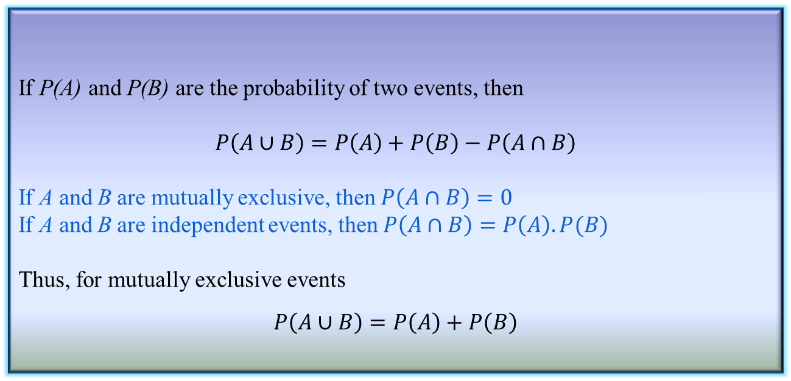
Joint Probability
Definition 8.3: Joint Probability
If P(A) and P(B) are the probability of two events, then
$$P\left(A∪B\right)=P\left(A\right)+P\left(B\right)−P\left(A∩B\right)$$
If A and B are mutually exclusive, then $P\left(A∩B\right)=0$
If A and B are independent events, then $P\left(A∩B\right)=P\left(A\right).P(B)$
Thus, for mutually exclusive events
$$P\left(A∪B\right)=P\left(A\right)+P\left(B\right)$$

Slide 29
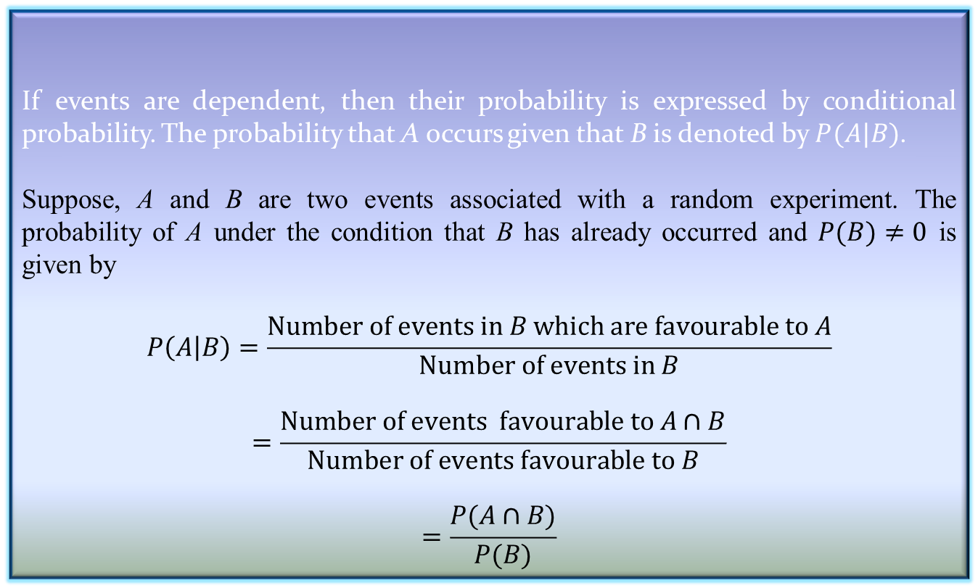
Conditional Probability
Definition 8.2: Conditional Probability
If events are dependent, then their probability is expressed by conditional probability. The probability that A occurs given that B is denoted by $P(A|B)$.
Suppose, A and B are two events associated with a random experiment. The probability of A under the condition that B has already occurred and $P(B)≠0$ is given by
$$P\left(A | B\right)=\frac{Number of events in B which are favourable to A}{Number of events in B}$$
$$=\frac{Number of events favourable to A∩B}{Number of events favourable to B}$$
$$=\frac{P(A∩B)}{P(B)}$$

Slide 30
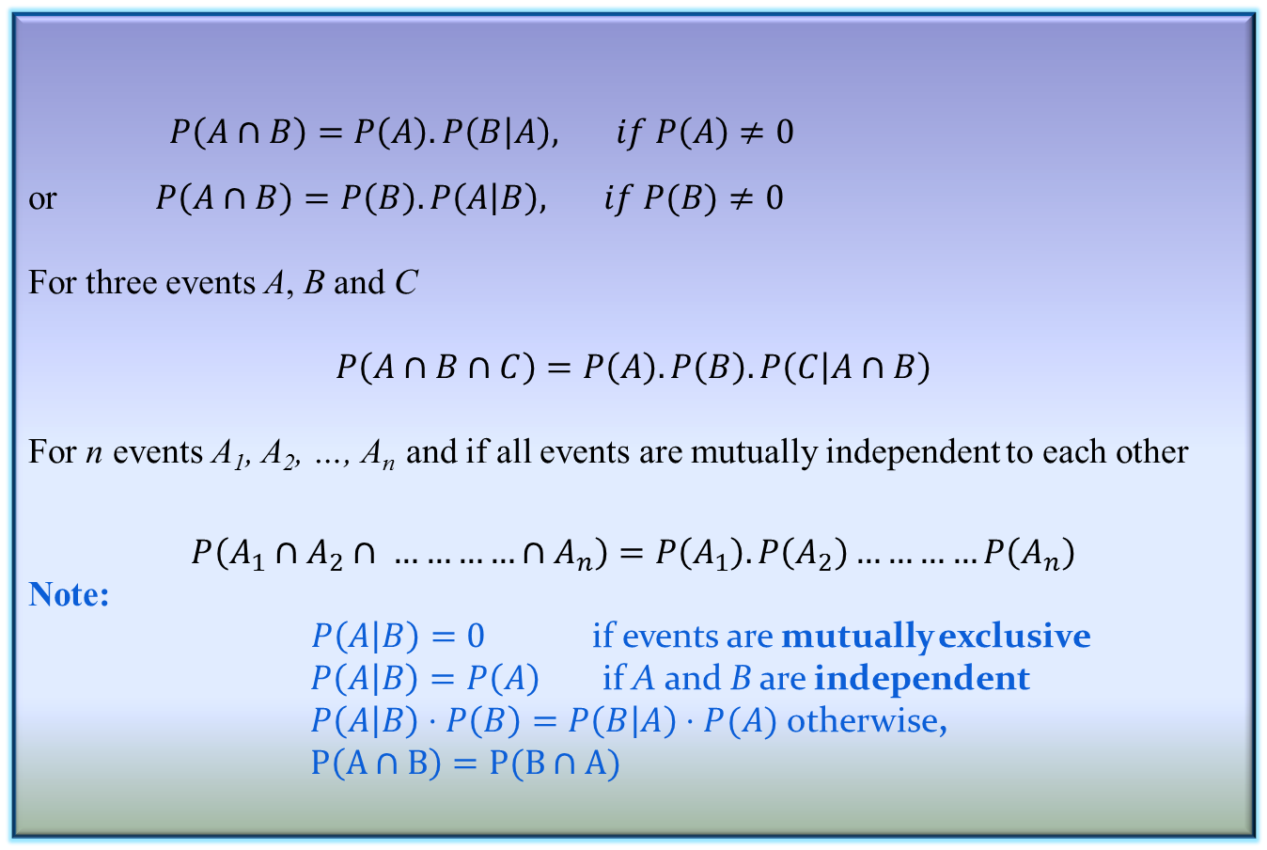
Conditional Probability
Corollary 8.1: Conditional Probability
$P\left(A∩B\right)=P\left(A\right).P\left(B | A\right), if P\left(A\right)≠0$
or $P\left(A∩B\right)=P\left(B\right).P\left(A | B\right), if P(B)≠0$
For three events A, B and C
$$P\left(A∩B∩C\right)=P\left(A\right).P\left(B\right).P\left(C | A∩B\right)$$
For n events A₁, A₂, …, A_{n} and if all events are mutually independent to each other
$$P\left(A_{1}∩A_{2}∩ …………∩A_{n}\right)=P\left(A_{1}\right).P\left(A_{2}\right)…………P\left(A_{n}\right)$$
Note:
$P\left(A | B\right)=0$ if events are mutually exclusive
$P\left(A | B\right)=P\left(A\right)$ if A and B are independent
$P\left(A | B\right)⋅P\left(B\right)=P\left(B | A\right)⋅P(A)$ otherwise,
$P\left(A∩B\right)=P(B∩A)$

Slide 31
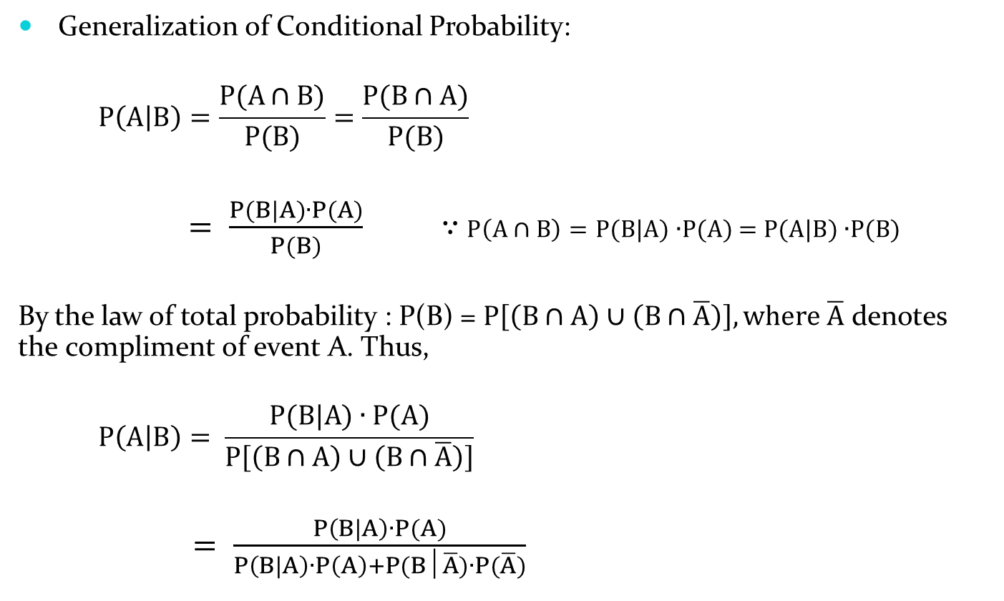
Conditional Probability
Generalization of Conditional Probability:
$$P\left(A | B\right)=\frac{P(A∩B)}{P(B)}=\frac{P(B∩A)}{P(B)}$$
$= \frac{P(B|A)∙P(A)}{P(B)}$ ∵ $P\left(A∩B\right)=P(B|A)$ $∙$P(A) = $P(A|B)$ $∙$P(B)
By the law of total probability : P(B) = $P\left[\left(B∩A\right)∪\left(B∩\overline{A}\right)\right],\text{where} \overline{A} \text{denotes} \text{the} \text{compliment} \text{of} \text{event} \text{A}\text{. }\text{Thus}\text{, }$
$$P\left(A | B\right)= \frac{P(B|A)∙P(A)}{P\left[\left(B∩A\right)∪\left(B∩\overline{A}\right)\right]}$$
$= \frac{P\left(B | A\right)∙P(A)}{P\left(B | A\right)∙P\left(A\right)+P(B│\overline{A})∙P(\overline{A})}$

Slide 32

Conditional Probability
In general,
$$P\left(A | D\right)=\frac{P(A) ∙P\left(D | A\right)}{P\left(A\right)∙P\left(D | A\right)+P\left(B\right)∙P\left(D | B\right)+P(C)∙P(D│C)}$$

Slide 33
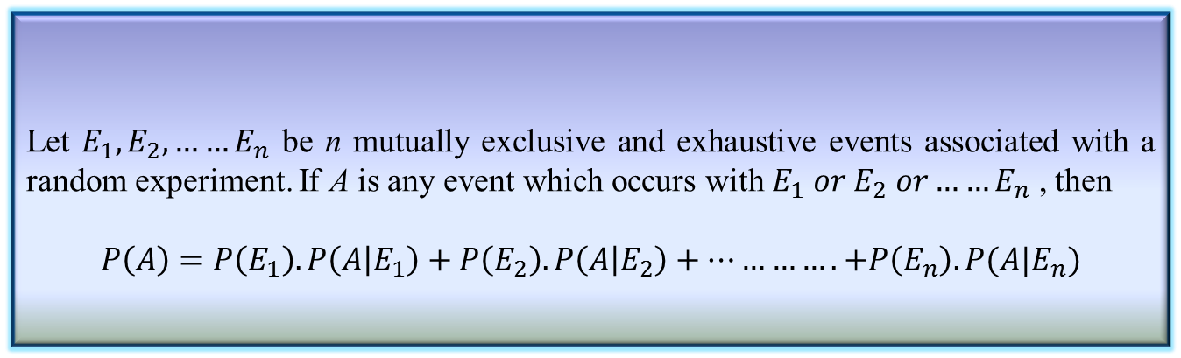
Total Probability
Definition 8.3: Total Probability
Let $E_{1},E_{2},……E_{n}$ be n mutually exclusive and exhaustive events associated with a random experiment. If A is any event which occurs with $E_{1} or E_{2} or……E_{n}$ , then
$$P\left(A\right)=P\left(E_{1}\right).P\left(A | E_{1}\right)+P\left(E_{2}\right).P\left(A | E_{2}\right)+………….+P\left(E_{n}\right).P(A|E_{n})$$
33

Slide 34
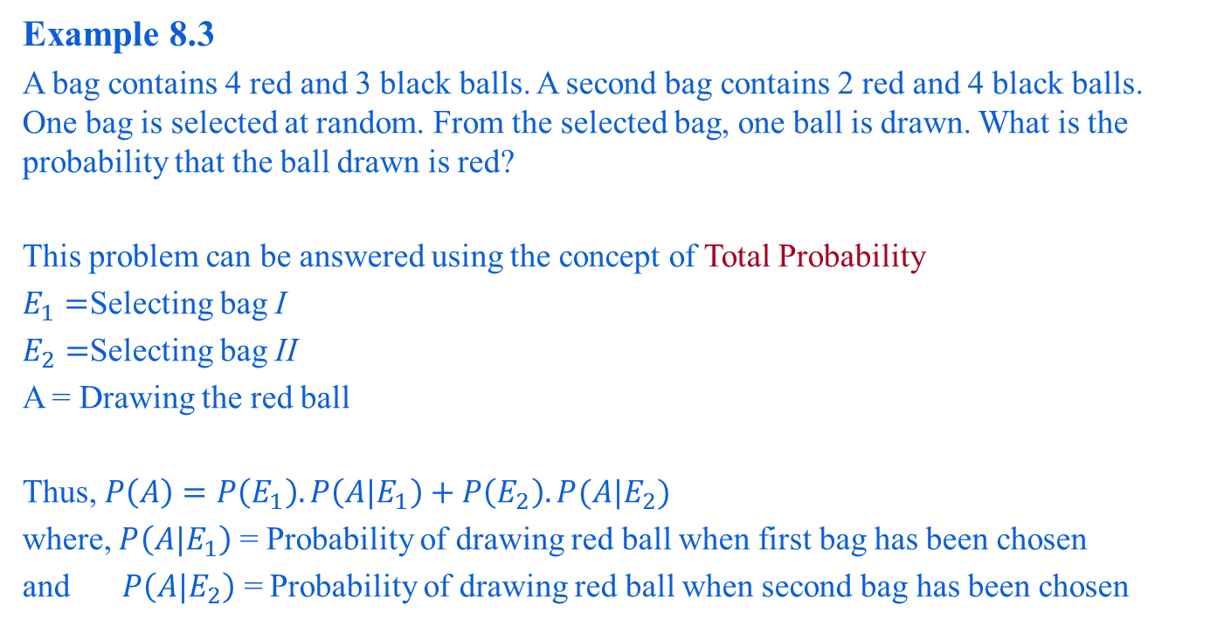
Total Probability: An Example
Example 8.3
A bag contains 4 red and 3 black balls. A second bag contains 2 red and 4 black balls. One bag is selected at random. From the selected bag, one ball is drawn. What is the probability that the ball drawn is red?
This problem can be answered using the concept of Total Probability
$E_{1}=$Selecting bag I
$E_{2}=$Selecting bag II
A = Drawing the red ball
Thus, $P\left(A\right)=P\left(E_{1}\right).P\left(A|E_{1}\right)+P\left(E_{2}\right).P(A|E_{2})$
where, $P\left(A|E_{1}\right)$ = Probability of drawing red ball when first bag has been chosen
and $P\left(A|E_{2}\right)$ = Probability of drawing red ball when second bag has been chosen

Slide 35
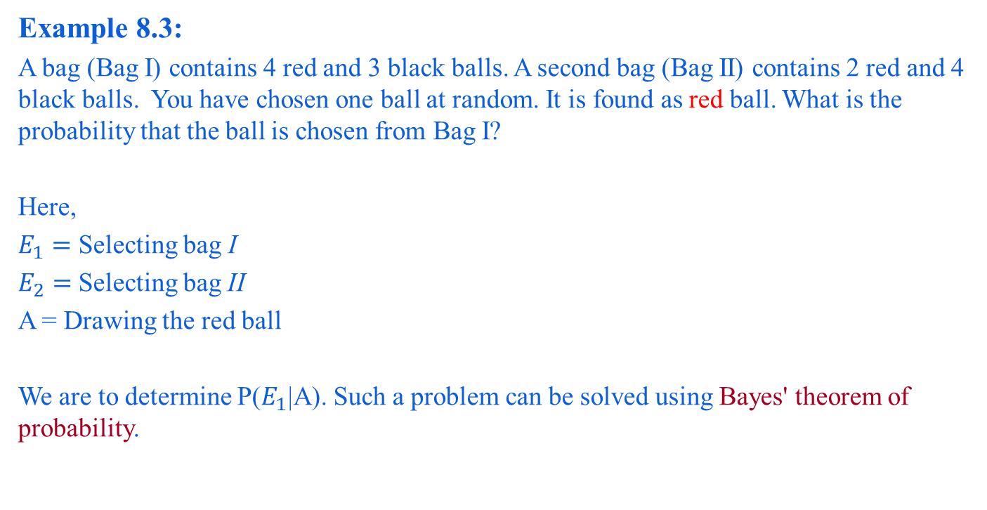
Reverse Probability
Example 8.3:
A bag (Bag I) contains 4 red and 3 black balls. A second bag (Bag II) contains 2 red and 4 black balls. You have chosen one ball at random. It is found as red ball. What is the probability that the ball is chosen from Bag I?
Here,
$E_{1}=$ Selecting bag I
$E_{2}=$Selecting bag II
A = Drawing the red ball
We are to determine P($E_{1}$|A). Such a problem can be solved using Bayes' theorem of probability.

Slide 36
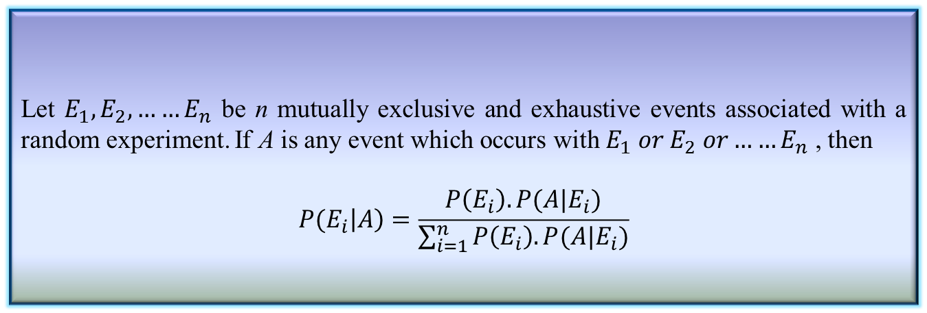
Bayes’ Theorem
Theorem 8.4: Bayes’ Theorem
Let $E_{1},E_{2},……E_{n}$ be n mutually exclusive and exhaustive events associated with a random experiment. If A is any event which occurs with $E_{1} or E_{2} or……E_{n}$ , then
$$P(E_{i}\left|A\right)=\frac{P\left(E_{i}\right).P(A|E_{i})}{\sum_{i=1}^{n}{P\left(E_{i}\right).P(A|E_{i})}}$$

Slide 37
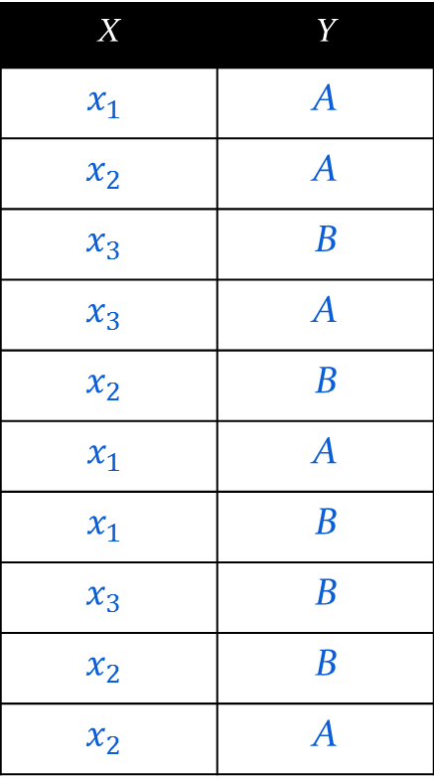
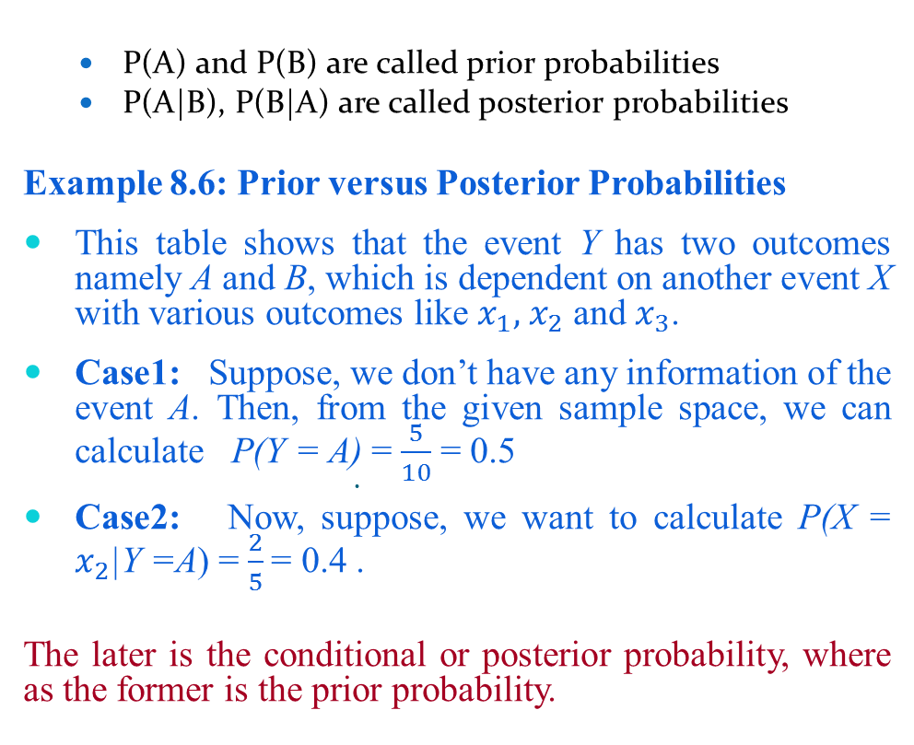
Prior and Posterior Probabilities
P(A) and P(B) are called prior probabilities
P(A|B), P(B|A) are called posterior probabilities
Example 8.6: Prior versus Posterior Probabilities
This table shows that the event Y has two outcomes namely A and B, which is dependent on another event X with various outcomes like $x_{1},{ x}_{2}$ and $x_{3}$.
Case1: Suppose, we don’t have any information of the event A. Then, from the given sample space, we can calculate P(Y = A) =$\frac{5}{10}$ = 0.5
Case2: Now, suppose, we want to calculate P(X = $x_{2}$|Y =A) =$\frac{2}{5}$ = 0.4 .
The later is the conditional or posterior probability, where as the former is the prior probability.
X | Y
$$x_{1}$$ | A
$$x_{2}$$ | A
$$x_{3}$$ | B
$$x_{3}$$ | A
$$x_{2}$$ | B
$$x_{1}$$ | A
$$x_{1}$$ | B
$$x_{3}$$ | B
$$x_{2}$$ | B
$$x_{2}$$ | A

Slide 38
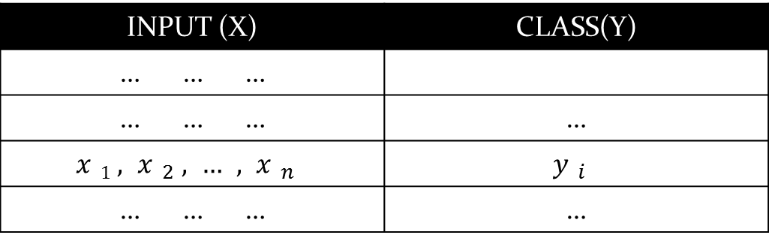
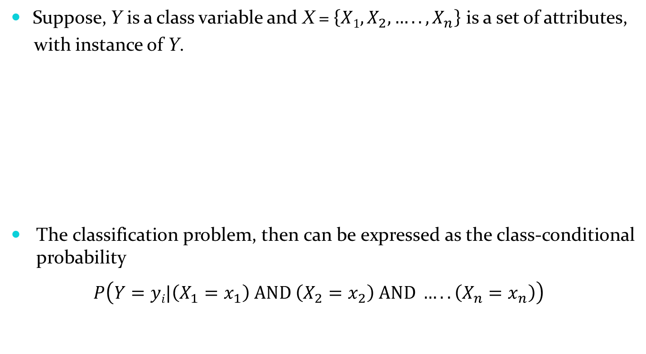
Naïve Bayesian Classifier
Suppose, Y is a class variable and X = $\left\{X1,X_{2},…..,X_{n}\right\}$ is a set of attributes,
with instance of Y.
The classification problem, then can be expressed as the class-conditional probability
$$P\left(Y=yi|\left(X_{1}=x_{1}\right) AND \left(X_{2}=x_{2}\right) AND …..\left(X_{n}=x_{n}\right)\right)$$
INPUT (X) | CLASS(Y)
… … …
… … … | …
$$x1,x_{2},…,x_{n}$$ | $$y_{i}$$
… … … | …

Slide 39
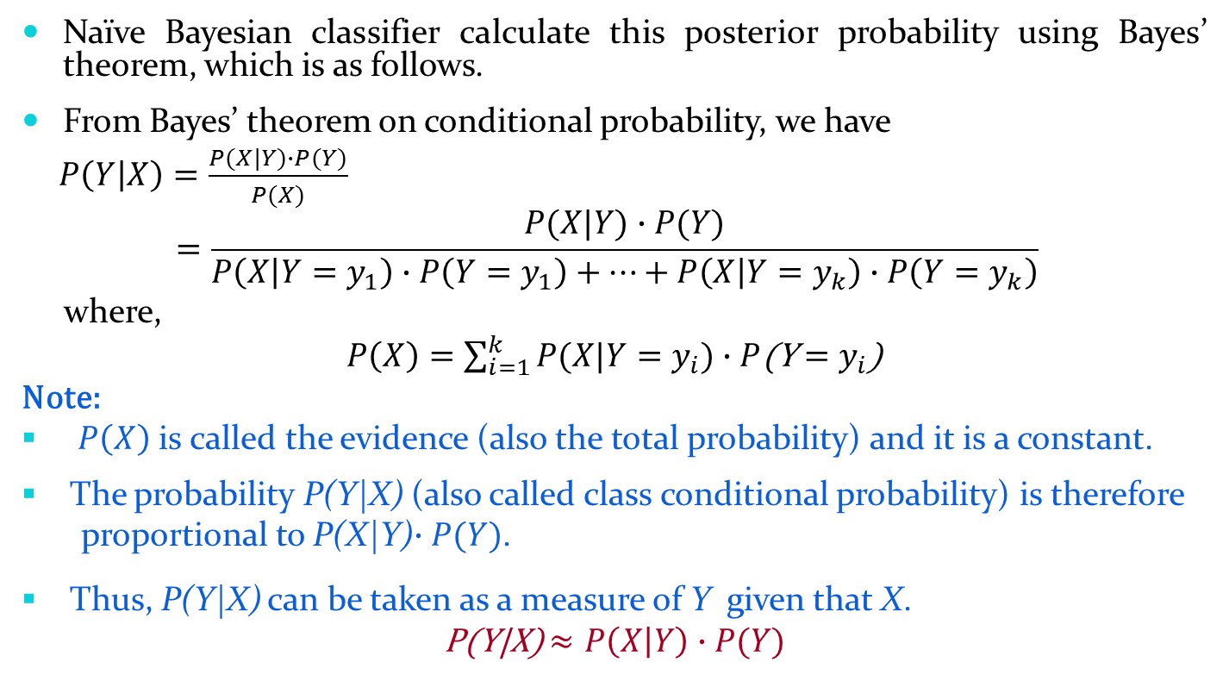
Naïve Bayesian Classifier
Naïve Bayesian classifier calculate this posterior probability using Bayes’ theorem, which is as follows.
From Bayes’ theorem on conditional probability, we have
$P\left(Y | X\right)=\frac{P(X|Y)∙P(Y)}{P(X)}$
$$=\frac{P(X|Y)∙P(Y)}{P\left(X | Y=y_{1}\right)∙P\left(Y=y_{1}\right)+…+P\left(X | Y=y_{k}\right)∙P\left(Y=y_{k}\right)}$$
where,
$P\left(X\right)=\sum_{i=1}^{k}{P(X|Y=y_{i}})∙P$(Y$=y_{i}$)
Note:
$P\left(X\right)$ is called the evidence (also the total probability) and it is a constant.
The probability P(Y|X) (also called class conditional probability) is therefore
proportional to P(X|Y)$∙P(Y)$.
Thus, P(Y|X) can be taken as a measure of Y given that X.
P(Y|X) $≈P\left(X | Y\right)∙P(Y)$

Slide 40
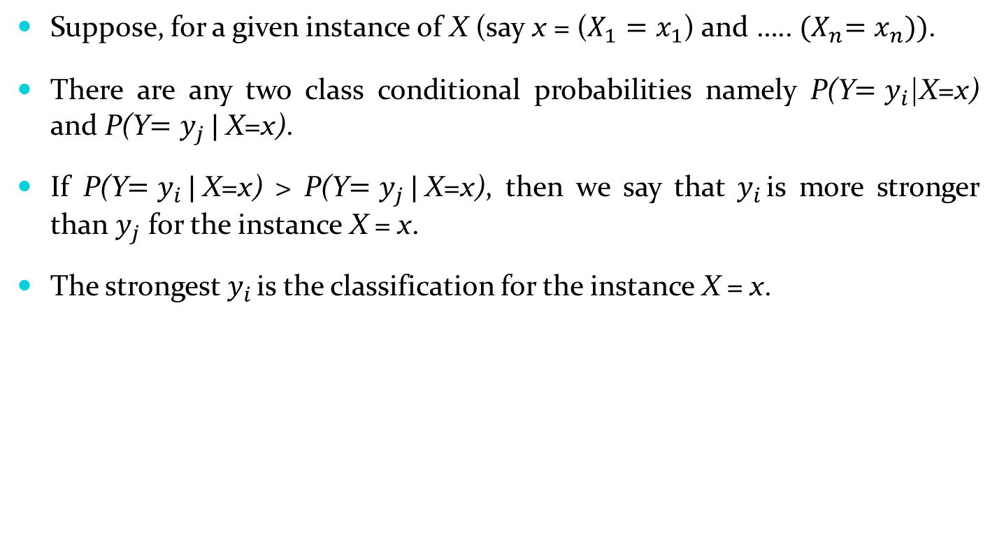
Naïve Bayesian Classifier
Suppose, for a given instance of X (say x = ($X_{1}=x_{1}$) and ….. ${(X}_{n}=x_{n}))$.
There are any two class conditional probabilities namely P(Y$=y_{i}$|X=x) and P(Y$=y_{j }|$X=x).
If P(Y$=y_{i }|$X=x) > P(Y$=y_{j }|$X=x), then we say that $y_{i }$is more stronger than $y_{j}$ for the instance X = x.
The strongest $y_{i }$is the classification for the instance X = x.

Slide 41
Naïve Bayesian Classifier
Example: With reference to the Air Traffic Dataset mentioned earlier, let us tabulate all the posterior and prior probabilities as shown below.
 |  | Class
Attribute |  | On Time | Late | Very Late | Cancelled
Day | Weekday | 9/14 = 0.64 | ½ = 0.5 | 3/3 = 1 | 0/1 = 0
 | Saturday | 2/14 = 0.14 | ½ = 0.5 | 0/3 = 0 | 1/1 = 1
 | Sunday | 1/14 = 0.07 | 0/2 = 0 | 0/3 = 0 | 0/1 = 0
 | Holiday | 2/14 = 0.14 | 0/2 = 0 | 0/3 = 0 | 0/1 = 0
Season | Spring | 4/14 = 0.29 | 0/2 = 0 | 0/3 = 0 | 0/1 = 0
 | Summer | 6/14 = 0.43 | 0/2 = 0 | 0/3 = 0 | 0/1 = 0
 | Autumn | 2/14 = 0.14 | 0/2 = 0 | 1/3= 0.33 | 0/1 = 0
 | Winter | 2/14 = 0.14 | 2/2 = 1 | 2/3 = 0.67 | 0/1 = 0

Slide 42
Naïve Bayesian Classifier
 |  | Class
Attribute |  | On Time | Late | Very Late | Cancelled
Fog | None | 5/14 = 0.36 | 0/2 = 0 | 0/3 = 0 | 0/1 = 0
 | High | 4/14 = 0.29 | 1/2 = 0.5 | 1/3 = 0.33 | 1/1 = 1
 | Normal | 5/14 = 0.36 | 1/2 = 0.5 | 2/3 = 0.67 | 0/1 = 0
Rain | None | 5/14 = 0.36 | 1/2 = 0.5 | 1/3 = 0.33 | 0/1 = 0
 | Slight | 8/14 = 0.57 | 0/2 = 0 | 0/3 = 0 | 0/1 = 0
 | Heavy | 1/14 = 0.07 | 1/2 = 0.5 | 2/3 = 0.67 | 1/1 = 1
Prior Probability |  | 14/20 = 0.70 | 2/20 = 0.10 | 3/20 = 0.15 | 1/20 = 0.05

Slide 43
Naïve Bayesian Classifier
Instance:
Case1: Class = On Time : 0.70 × 0.64 × 0.14 × 0.29 × 0.07 = 0.0013
Case2: Class = Late : 0.10 × 0.50 × 1.0 × 0.50 × 0.50 = 0.0125
Case3: Class = Very Late : 0.15 × 1.0 × 0.67 × 0.33 × 0.67 = 0.0222
Case4: Class = Cancelled : 0.05 × 0.0 × 0.0 × 1.0 × 1.0 = 0.0000
Case3 is the strongest; Hence correct classification is Very Late
Week Day | Winter | High | Heavy | ???

Slide 44
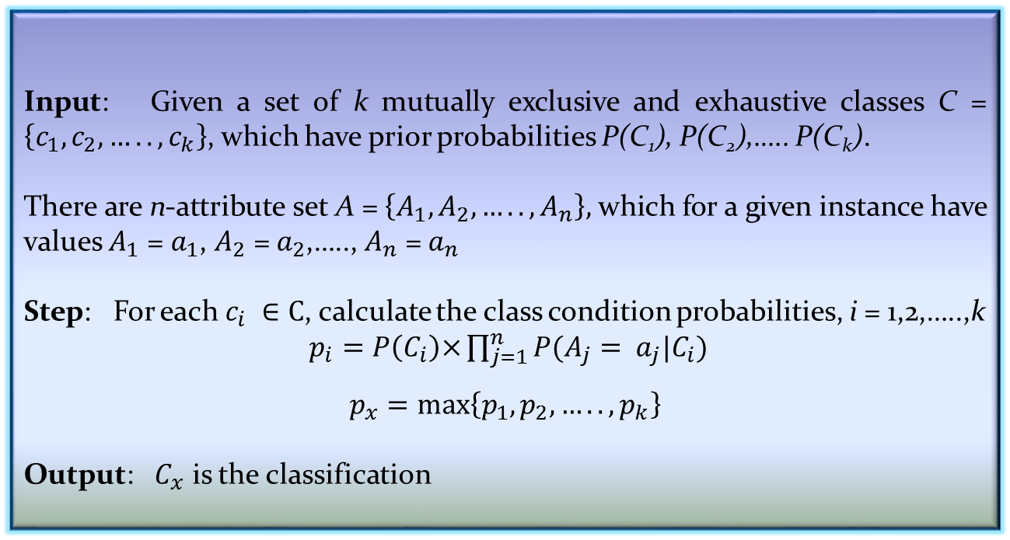
Naïve Bayesian Classifier
Input: Given a set of k mutually exclusive and exhaustive classes C = $\left\{c_{1},c_{2},…..,c_{k}\right\}$, which have prior probabilities P(C₁), P(C₂),….. P(C_{k}).
There are n-attribute set A = $\left\{A_{1},A_{2},…..,A_{n}\right\},$ which for a given instance have values $A_{1}$ = $a_{1}$, $A_{2}$ = $a_{2}$,….., $A_{n}$ = $a_{n}$
Step: For each $c_{i} ∈C$, calculate the class condition probabilities, i = 1,2,…..,k
$p_{i}=P\left(C_{i}\right)\text{×}\prod_{j=1}^{n}{P(A_{j}= a_{j}|C_{i}})$
$$p_{x}=\max\left\{p_{1},p_{2},…..,p_{k}\right\}$$
Output: $C_{x}$ is the classification
Algorithm: Naïve Bayesian Classification

Slide 45
Naïve Bayesian Classifier
Pros and Cons
The Naïve Bayes’ approach is a very popular one, which often works well.
However, it has a number of potential problems
It relies on all attributes being categorical.
If the data is less, then it estimates poorly.

Slide 46
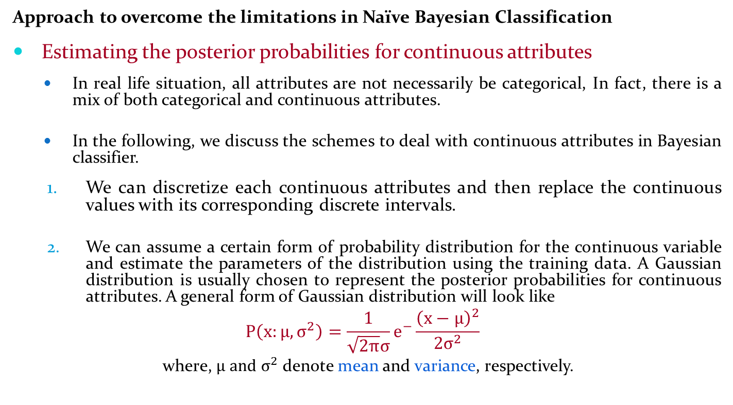
Naïve Bayesian Classifier
Approach to overcome the limitations in Naïve Bayesian Classification
Estimating the posterior probabilities for continuous attributes
In real life situation, all attributes are not necessarily be categorical, In fact, there is a mix of both categorical and continuous attributes.
In the following, we discuss the schemes to deal with continuous attributes in Bayesian classifier.
We can discretize each continuous attributes and then replace the continuous values with its corresponding discrete intervals.
We can assume a certain form of probability distribution for the continuous variable and estimate the parameters of the distribution using the training data. A Gaussian distribution is usually chosen to represent the posterior probabilities for continuous attributes. A general form of Gaussian distribution will look like
$$P\left(x:μ,σ^{2}\right)=\frac{1}{\sqrt{2π}σ}e^{−}\frac{{\left(x−μ\right)}^{2}}{2σ^{2}}$$
where, $μ and σ^{2}$ denote mean and variance, respectively.

Slide 47
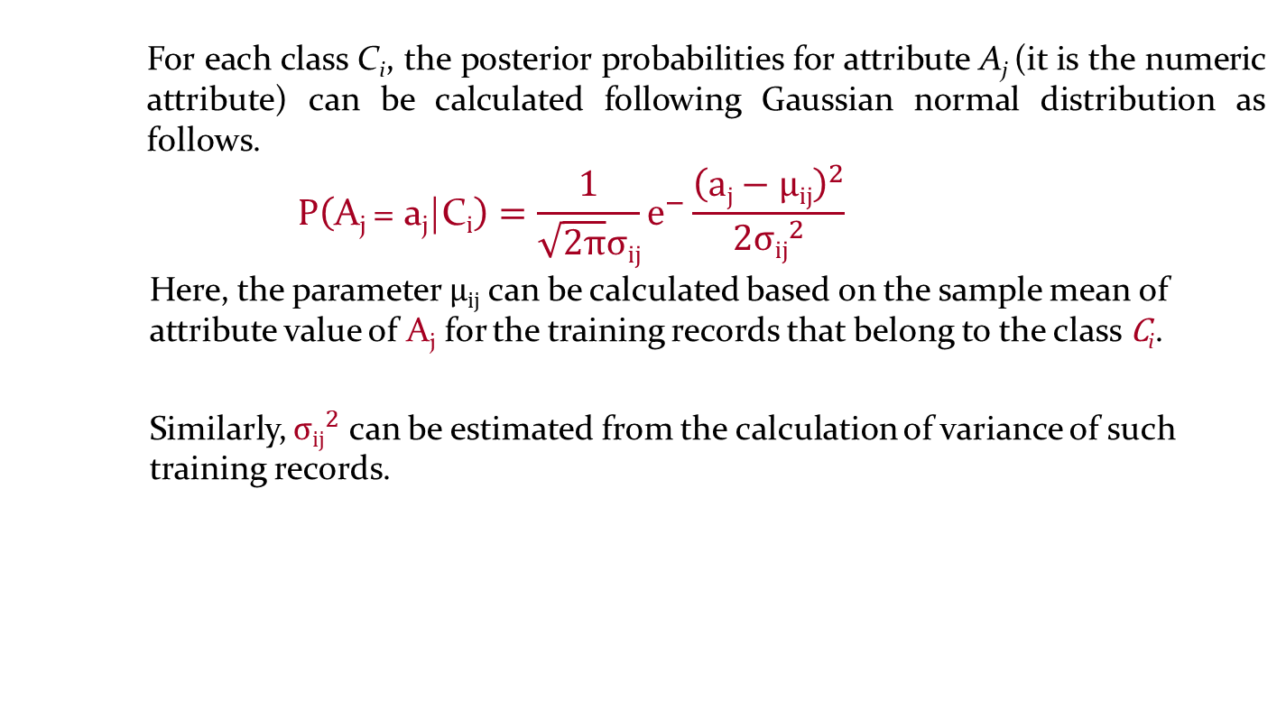
Naïve Bayesian Classifier
For each class C_{i}, the posterior probabilities for attribute A_{j} (it is the numeric attribute) can be calculated following Gaussian normal distribution as follows.
$$P\left(\text{A}\text{j} \text{=} \text{a}\text{j}\text{|}\text{C}i\right)=\frac{1}{\sqrt{2π}σij}e^{−}\frac{{\left(aj−μij\right)}^{2}}{2{σij}^{2}}$$
Here, the parameter $μij$ can be calculated based on the sample mean of attribute value of $\text{A}\text{j}$ for the training records that belong to the class $\text{C}\text{i}$.
Similarly, ${σij}^{2}$ can be estimated from the calculation of variance of such training records.

Slide 48
Naïve Bayesian Classifier
M-estimate of Conditional Probability
The M-estimation is to deal with the potential problem of Naïve Bayesian Classifier when training data size is too poor.
If the posterior probability for one of the attribute is zero, then the overall class-conditional probability for the class vanishes.
In other words, if training data do not cover many of the attribute values, then we may not be able to classify some of the test records.
This problem can be addressed by using the M-estimate approach.

Slide 49
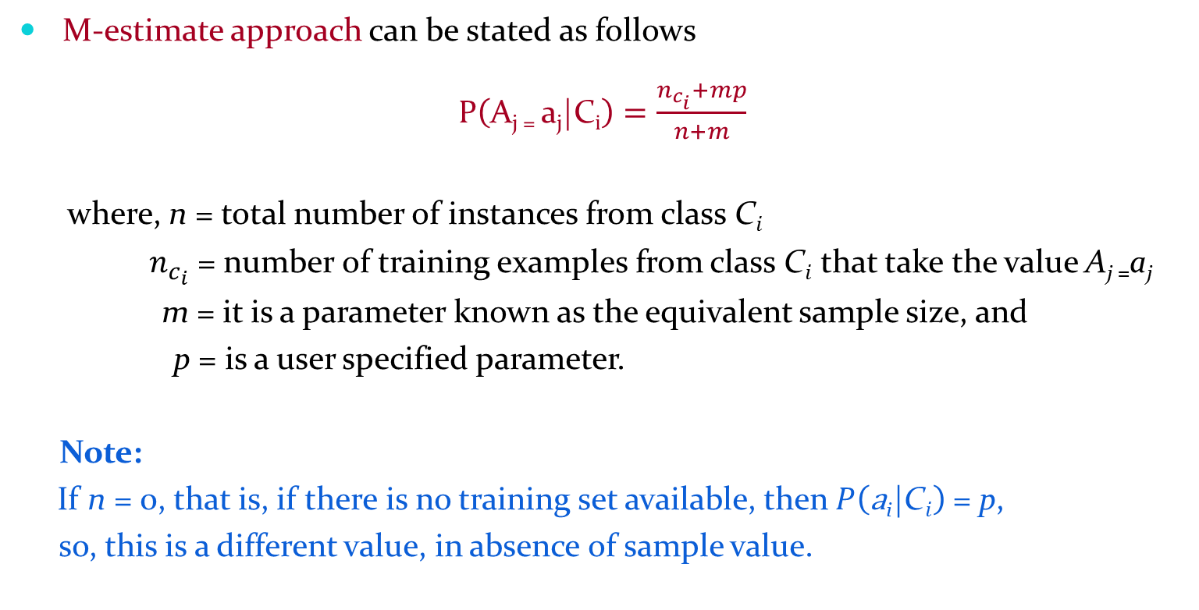
M-estimate Approach
M-estimate approach can be stated as follows
$P\left(\text{A}\text{j}\text{ = }\text{a}\text{j}\text{|}\text{C}i\right)=\frac{n_{c_{i}}+mp}{n+m}$
where, n = total number of instances from class $\text{C}i$
$n_{c_{i}}$ = number of training examples from class $\text{C}i$ that take the value $\text{A}\text{j}\text{ =}\text{a}\text{j}$
m = it is a parameter known as the equivalent sample size, and
p = is a user specified parameter.
Note:
If n = 0, that is, if there is no training set available, then $P\left(\text{a}\text{i}\text{|}\text{C}i\right)$ = p,
so, this is a different value, in absence of sample value.

Slide 50
A Practice Example
Example 8.4
Class:
C1:buys_computer = ‘yes’
C2:buys_computer = ‘no’
Data instance
X = (age <=30,
Income = medium,
Student = yes
Credit_rating = fair)

Slide 51
A Practice Example
P(C_{i}): P(buys_computer = “yes”) = 9/14 = 0.643
P(buys_computer = “no”) = 5/14= 0.357
Compute P(X|C_{i}) for each class
P(age = “<=30” | buys_computer = “yes”) = 2/9 = 0.222
P(age = “<= 30” | buys_computer = “no”) = 3/5 = 0.6
P(income = “medium” | buys_computer = “yes”) = 4/9 = 0.444
P(income = “medium” | buys_computer = “no”) = 2/5 = 0.4
P(student = “yes” | buys_computer = “yes) = 6/9 = 0.667
P(student = “yes” | buys_computer = “no”) = 1/5 = 0.2
P(credit_rating = “fair” | buys_computer = “yes”) = 6/9 = 0.667
P(credit_rating = “fair” | buys_computer = “no”) = 2/5 = 0.4
X = (age <= 30 , income = medium, student = yes, credit_rating = fair)
P(X|C_{i}) : P(X|buys_computer = “yes”) = 0.222 × 0.444 × 0.667 × 0.667 = 0.044
P(X|buys_computer = “no”) = 0.6 × 0.4 × 0.2 × 0.4 = 0.019
P(X|C_{i})*P(C_{i}) : P(X|buys_computer = “yes”) * P(buys_computer = “yes”) = 0.028
P(X|buys_computer = “no”) * P(buys_computer = “no”) = 0.007
Therefore, X belongs to class (“buys_computer = yes”)

Slide 52
Reference
The detail material related to this lecture can be found in
Data Mining: Concepts and Techniques, (3rd Edn.), Jiawei Han, Micheline Kamber, Morgan Kaufmann, 2015.
Introduction to Data Mining, Pang-Ning Tan, Michael Steinbach, and Vipin Kumar, Addison-Wesley, 2014

